Slide 1




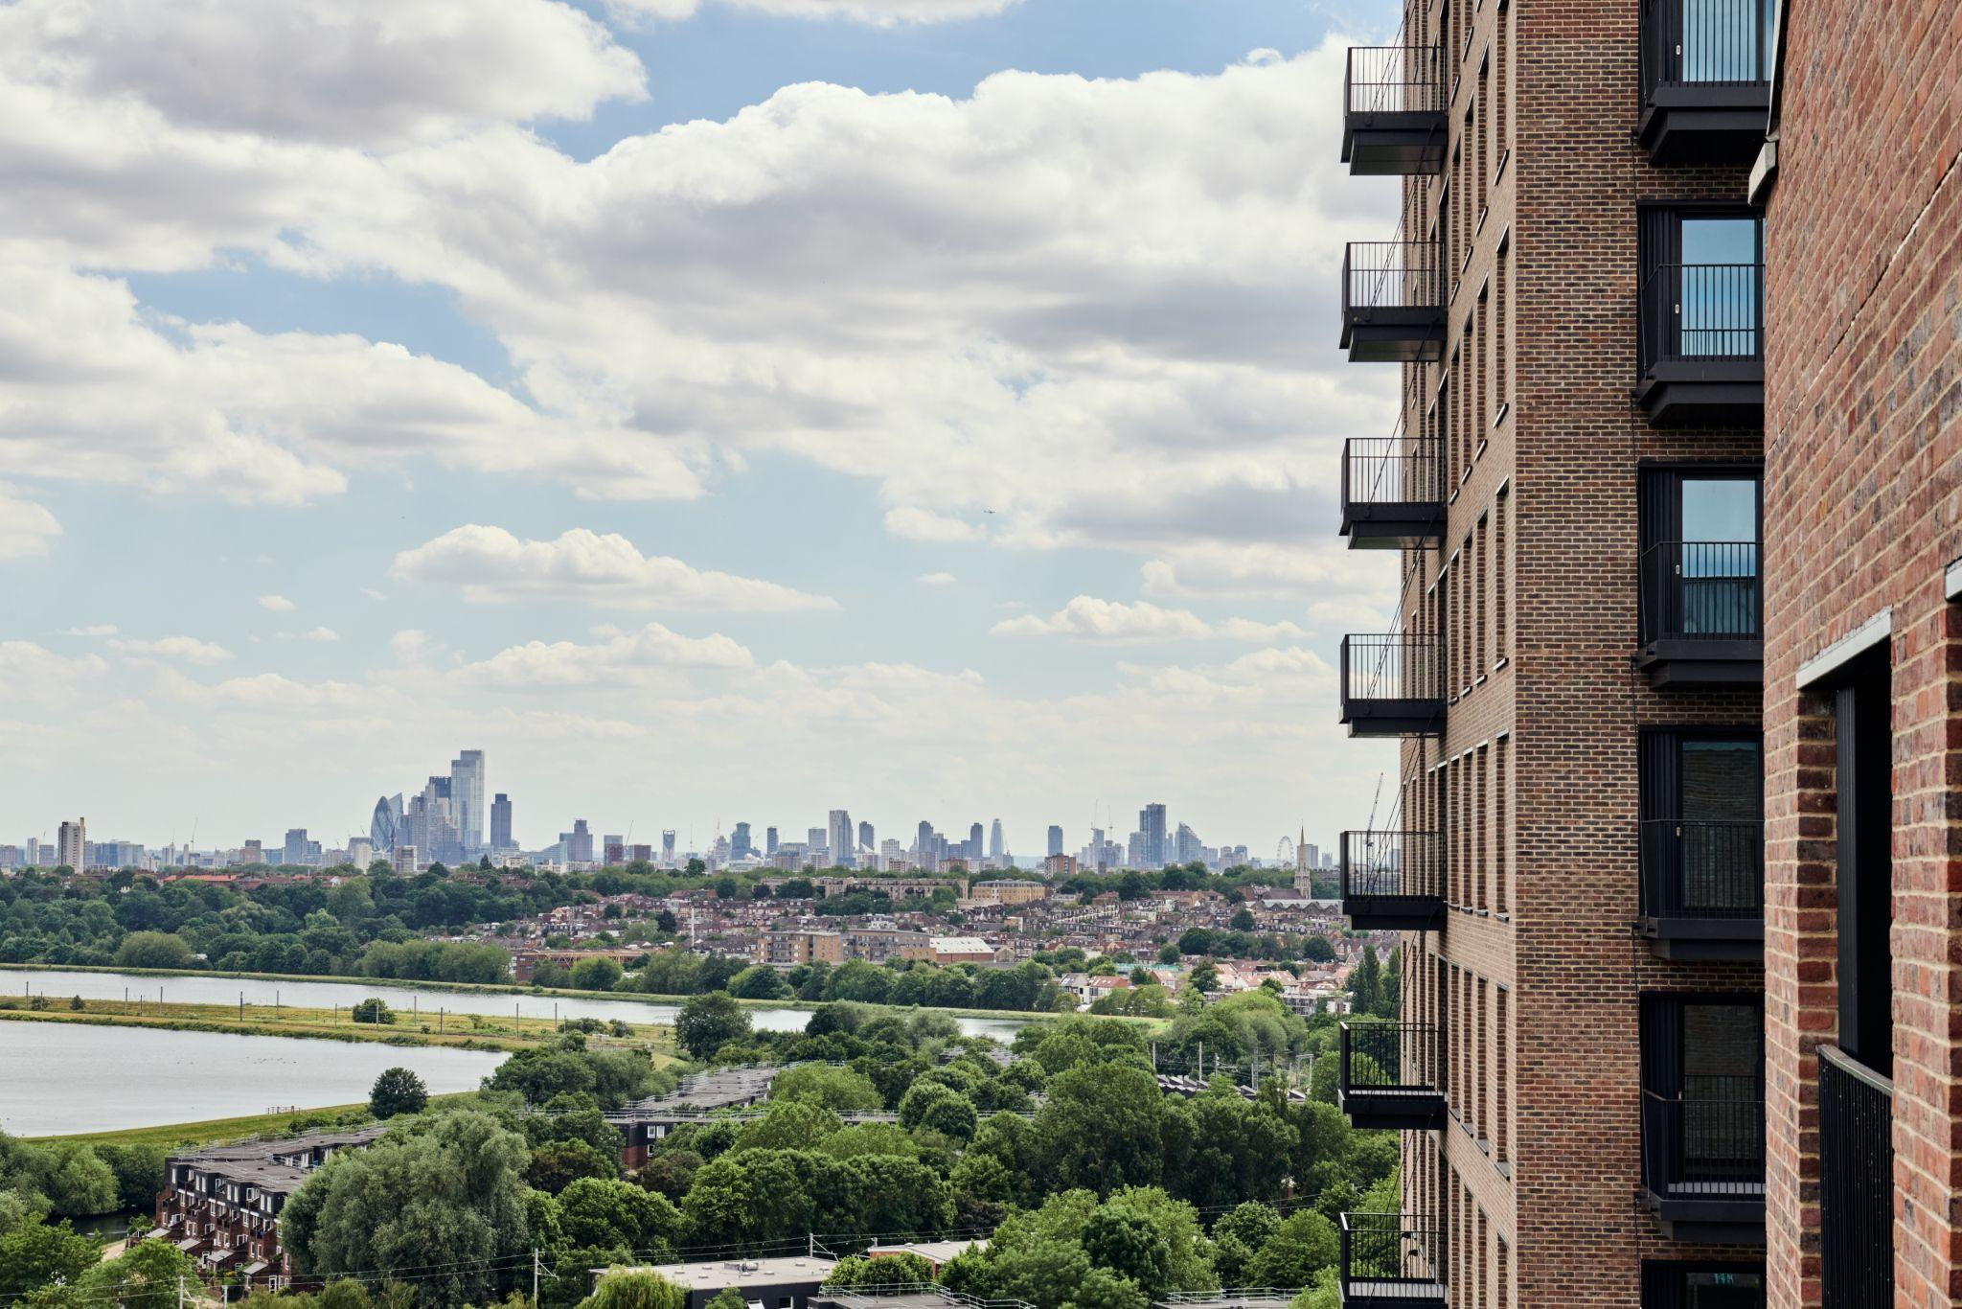
Grainger Illuminate - Screen Shots
Persona Library HERE
Images by Industry:
Consumer Goods
Education
Construction
Finance
HLS
Hospitality
Oil and Gas
Media and Communications
Sports
Notes:
FJ

Slide 2
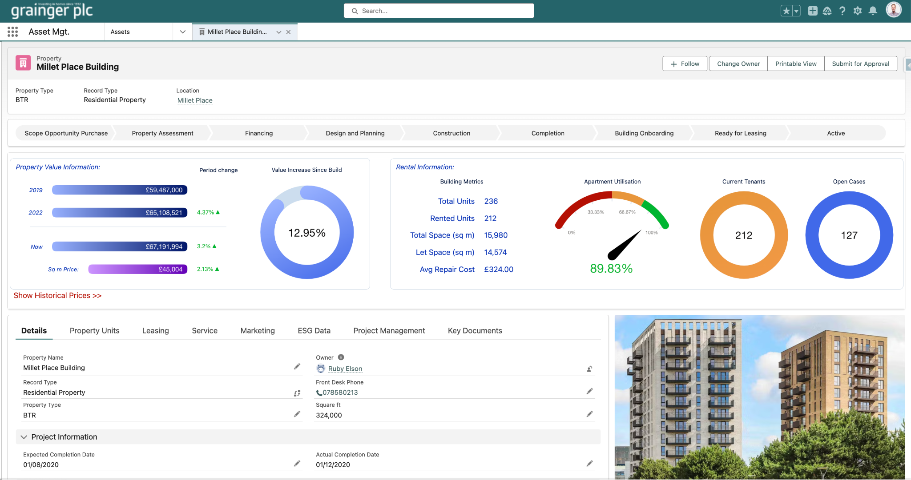


Slide 3
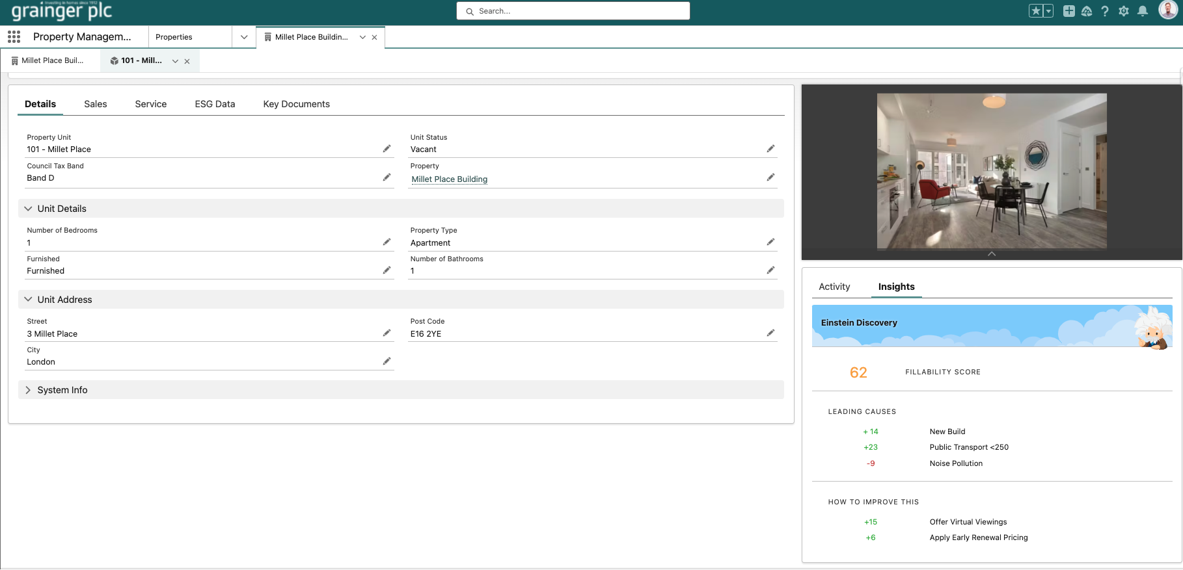

Slide 4
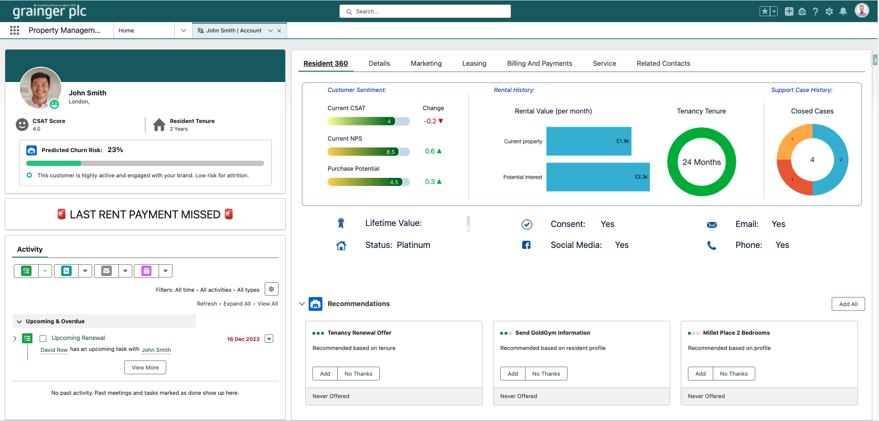

Slide 5
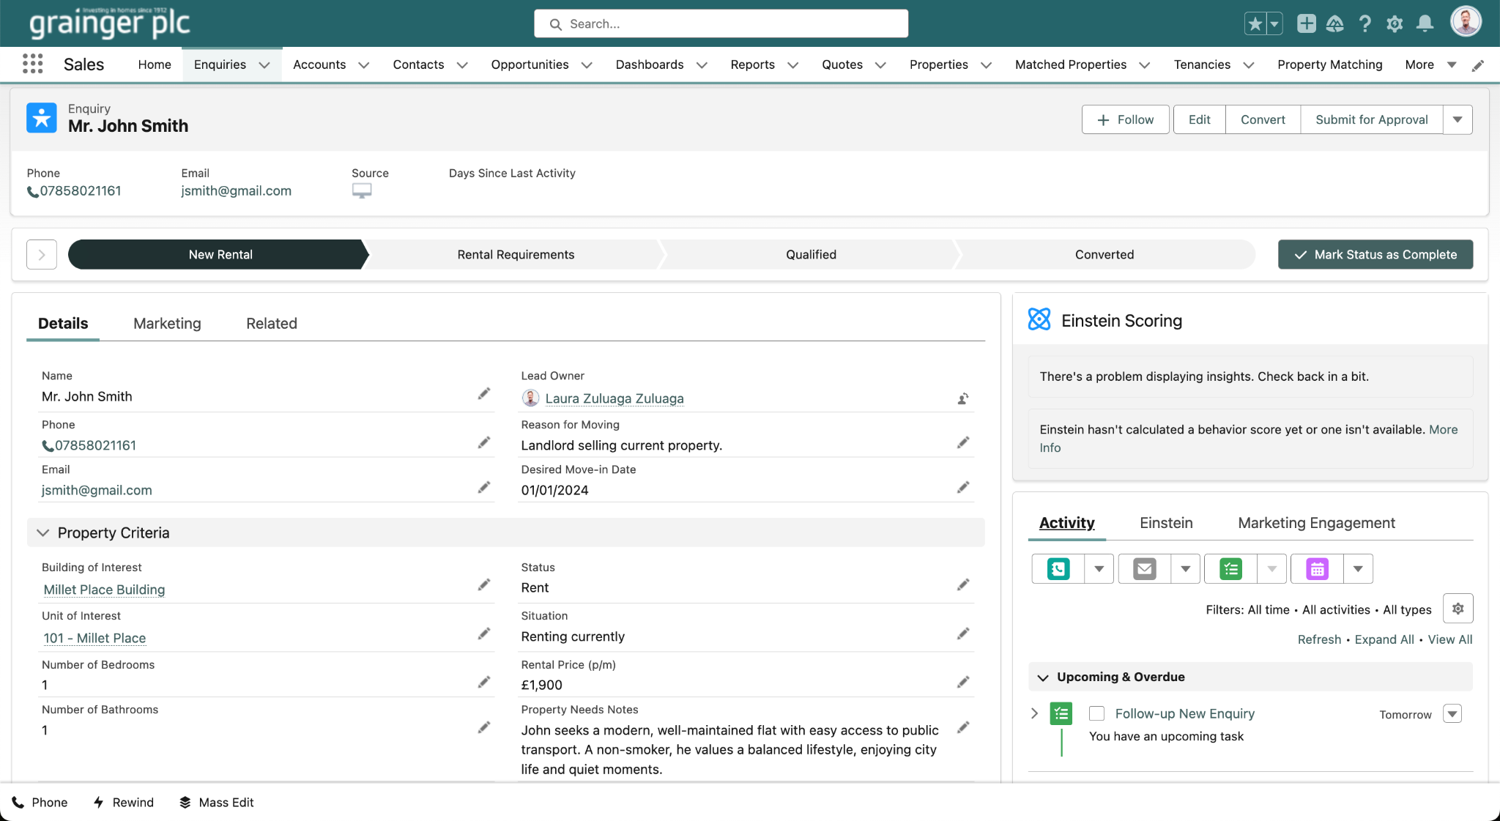
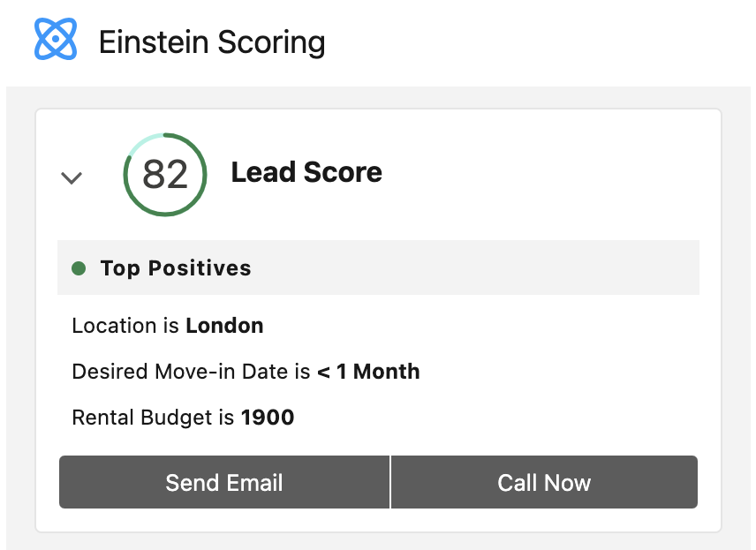

Slide 6
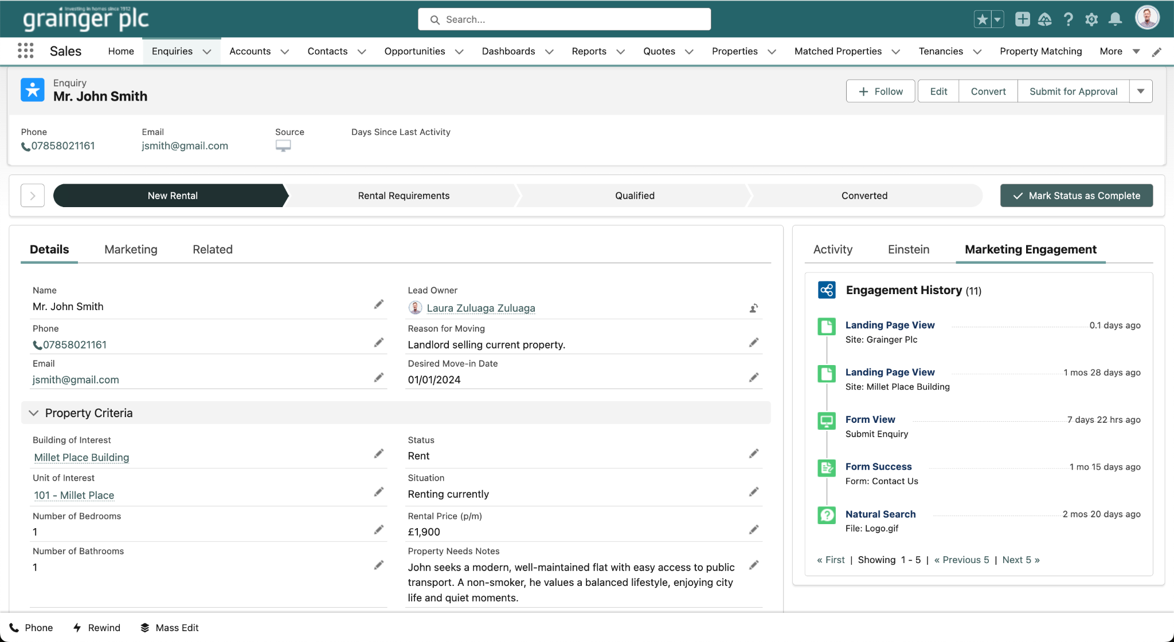

Slide 7
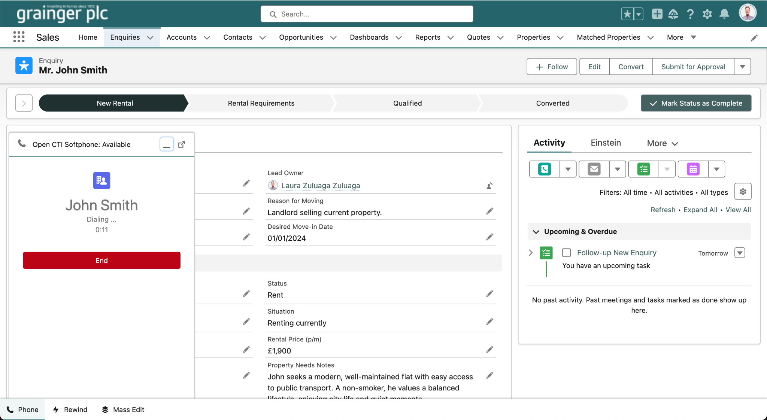

Slide 8
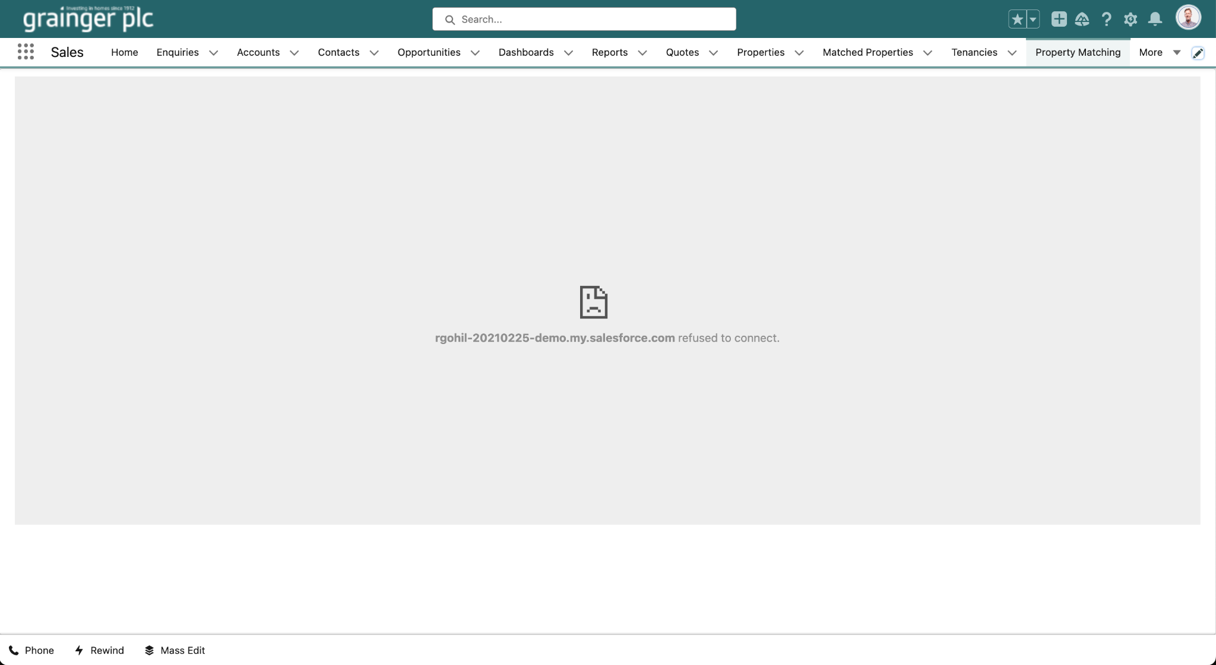
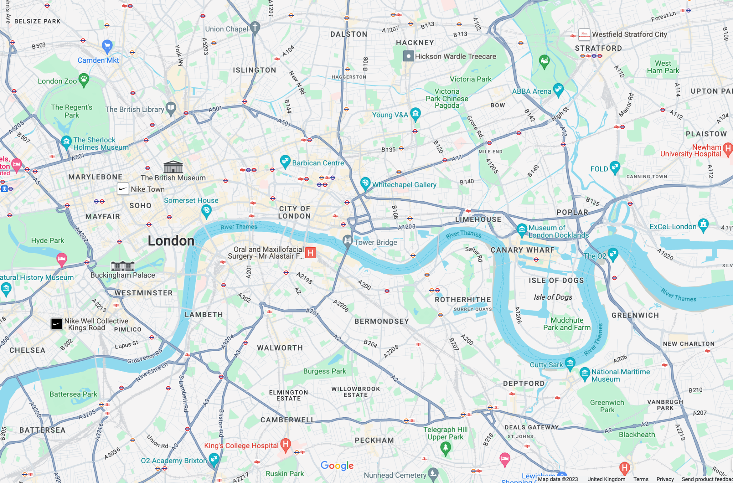

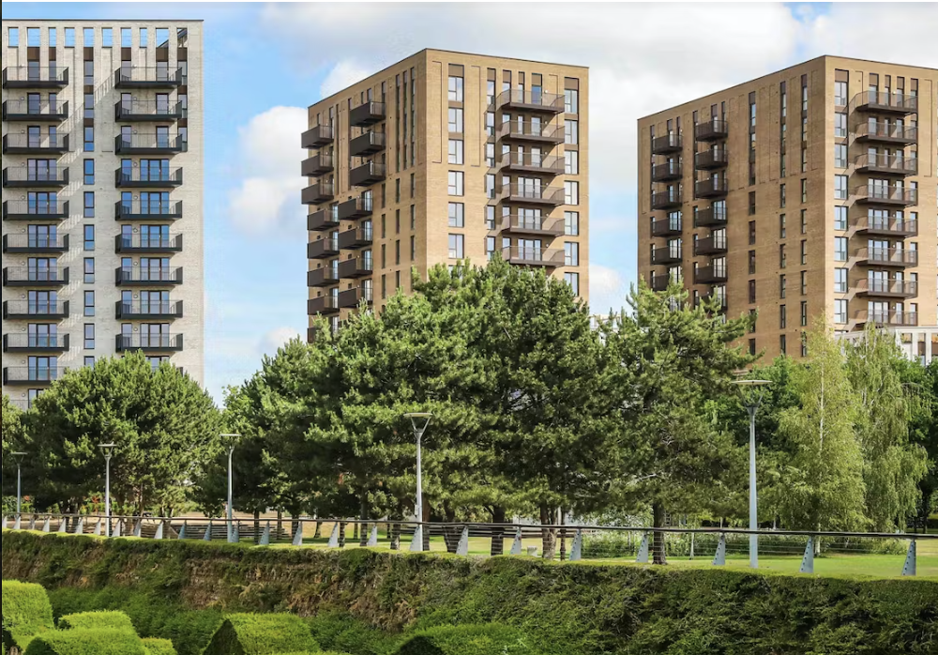
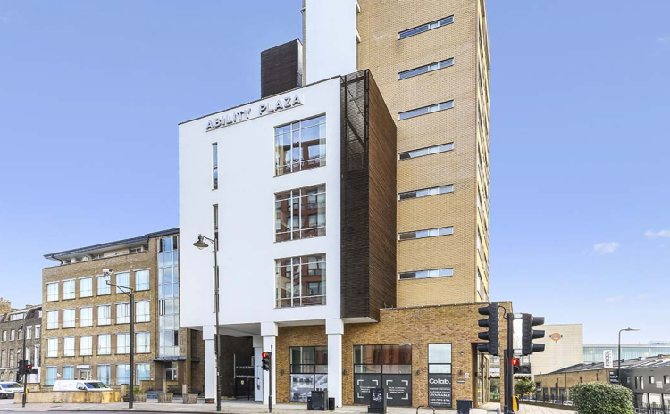
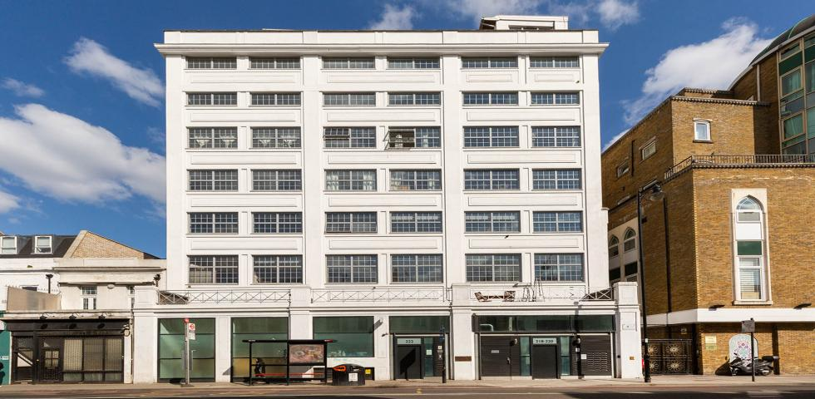
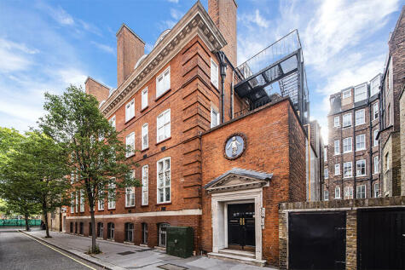
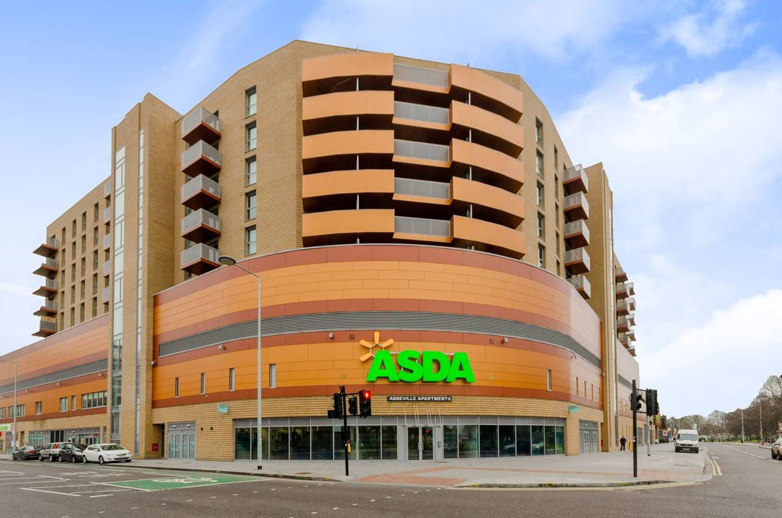
Millet Place Building
Furnished, Pet Friendly, Roof Terrace
Brand new apartments at Millet Place with stylish interiors, balconies and close to transport links to London
See Units
Ability Plaza
Modern, Furnished, Parking
Ability Plaza offers open plan, modern live/work apartments with loft style features and great natural..
See Units
Ability View
Modern, Furnished, Parking
Ability Plaza offers open plan, modern live/work apartments with loft style features and great natural..
See Units
Pimlico London
Modern, Furnished, Parking
Kimmerston House provides all-inclusive living in Central London. With shared communal facilities..
See Units
Abbeville Apartments
New Build, Moder, Unfurnished
Situated in the heart of Barking, Abbeville offers 1, 2, and 3 bedroom apartments for rent.
See Units
1, 2. 3. 4. 5. 7, 8
Back
Next

Slide 9
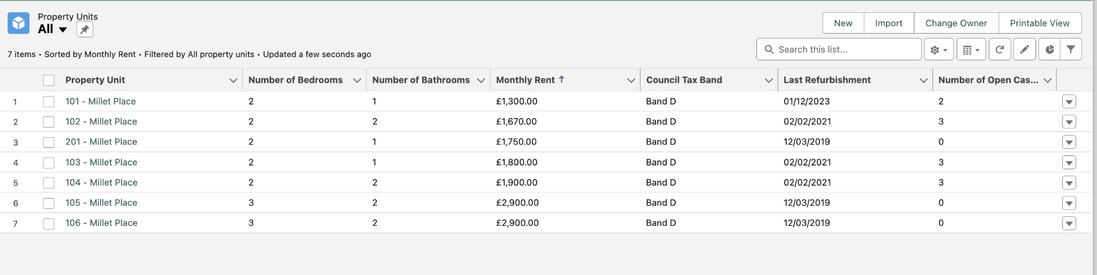

Millet Place Building
Furnished, Pet Friendly, Roof Terrace
Brand new apartments at Millet Place with stylish interiors, balconies and close to transport links to London
See Units
Available Units
Ability Plaza
Search...
Modern, Furnished, Parking
Search...
Ability Plaza offers open plan, modern live/work apartments with loft style features and great natural..
See Units
Ability View
Modern, Furnished, Parking
Ability Plaza offers open plan, modern live/work apartments with loft style features and great natural..
See Units
Pimlico London
Cancel
Modern, Furnished, Parking
Select
Kimmerston House provides all-inclusive living in Central London. With shared communal facilities..
See Units
Abbeville Apartments
New Build, Moder, Unfurnished
Situated in the heart of Barking, Abbeville offers 1, 2, and 3 bedroom apartments for rent.
See Units
1, 2. 3. 4. 5. 7, 8
Back
Next

Slide 10
